Slide 1
Smart Touchless Control with Millimeter-Wave Radar Sensor and Artificial Intelligence
DIP: AY2122s1 - E047
Supervisor: Prof LU YiLong
11 Aug 2021

Slide 2

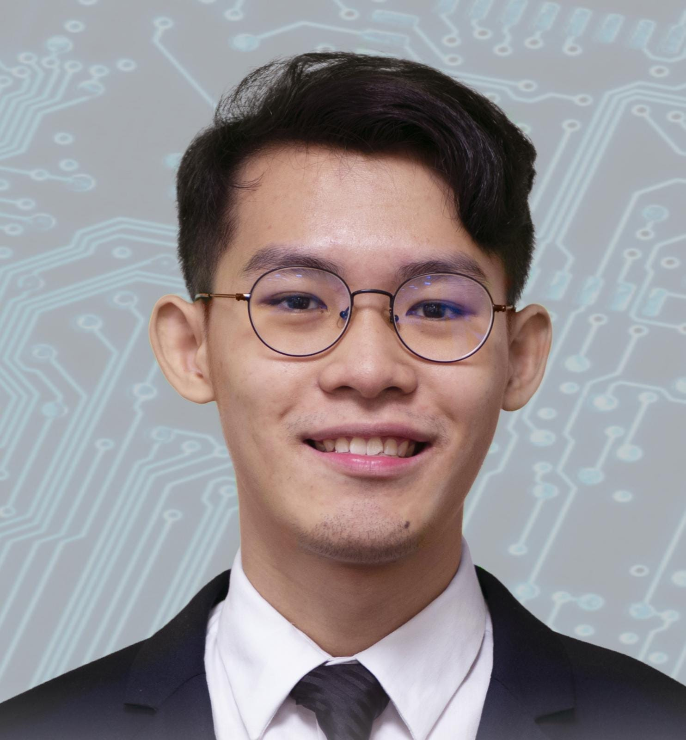
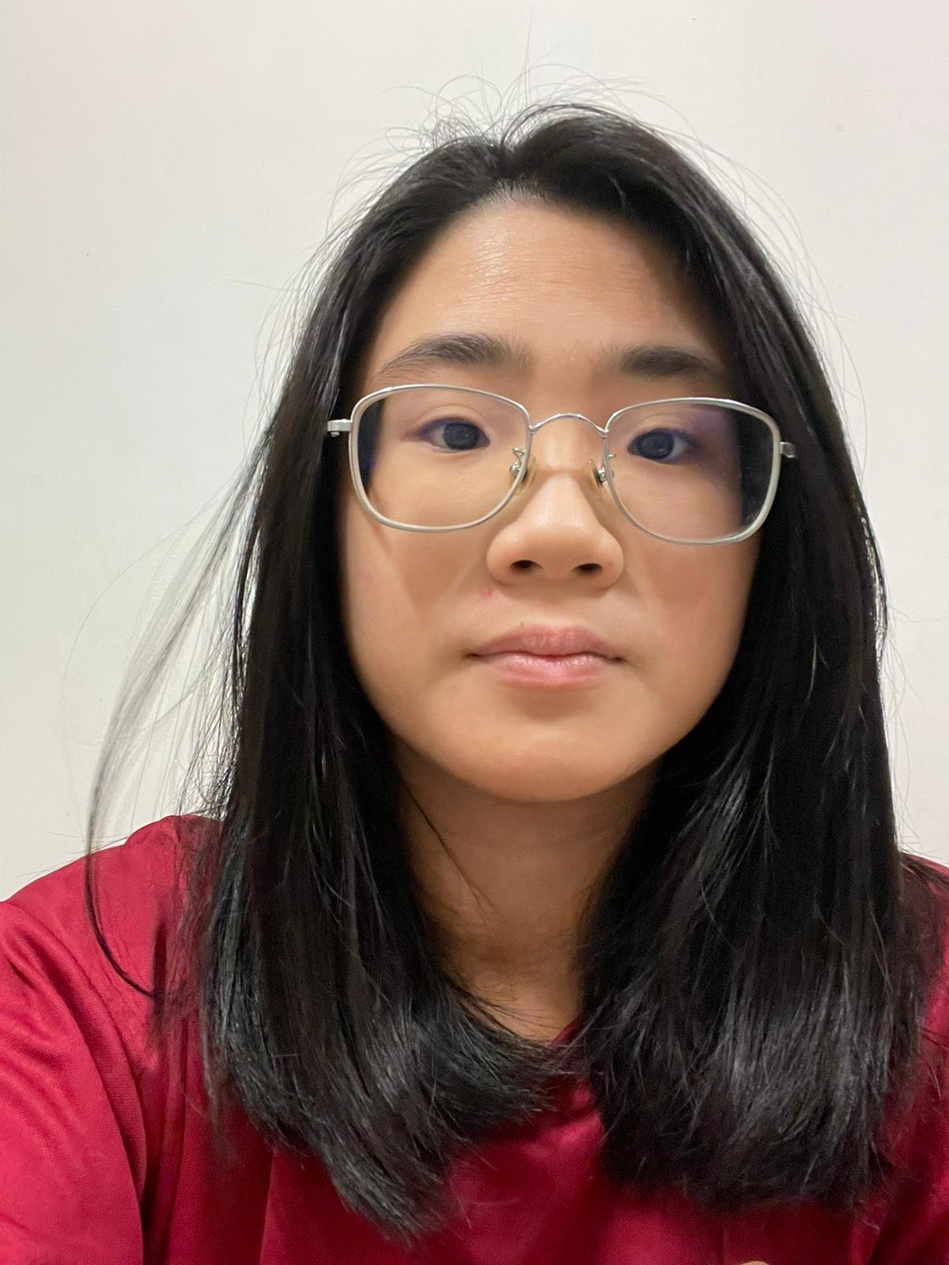
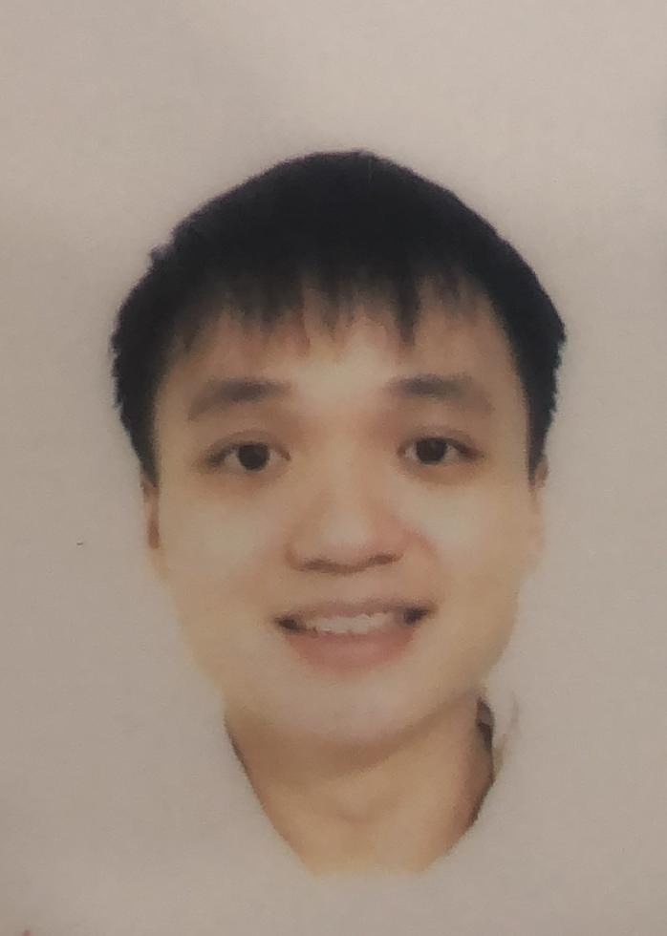
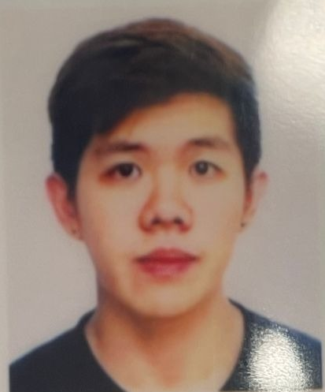
0. Students & Plan
Group Leader: Philip Lee Hann Yung
Treasurer: Thum Yi Wen
Sub-group 1:
Sub-group 2:
photo | photo | photo | photo | photo
PHILIP LEE HANN YUNG | LEE WAI YEONG | THUM YI WEN | TAN WEN HAN DAVIS | GOH JUN DE
PLEE016@e.ntu.edu.sg | WLEE086@e.ntu.edu.sg | THUM0010@e.ntu.edu.sg | DTAN118@e.ntu.edu.sg | JGOH117@e.ntu.edu.sg
94708875 | 81304199 | 84258300 | 83498287 | 90096863

Slide 3
Plan & Schedule
Plan & Schedule
Tasks | Week
 | 1 | 2 | 3 | 4 | 5 | 6 | 7 | 8 | 9 | 10 | 11 | 12 | 13
Background information and theory
Purchasing radar sensor and Rasbery Pi
Sample radar signal/data processing in Matlab
Sample ML processing in Matlab
Radar signal/data processing in Rasbery Pi
ML processing in Rasbery Pi
Integration and Testing

Slide 4
1. Introduction
Background
Coronavirus has created a growing unease at the use of shared handles/buttons/touchscreens.
Advances in touchless technology could be the answer and millimetre-wave (mmWave) radar plus artificial intelligence (AI) is the most promising solution.
Touchless gesture control, is a natural, convenient, and hygienic way of human-computer interaction (HCI) and it is considered the Future HCI for the emerging Low Touch Economy.
Objective
Explore a smart touchless control innovation using low-cost commercial mmWave radar sensor and suitable AI algorithms for simple and effective hand gesture sensing and control of a flexible HCI with unlimited applications.
Scope
radar concepts, commercial 60 GHz radar sensor, radar data processing, AI algorithm, and Raspberry Pi micro-computer implementation.

Slide 5
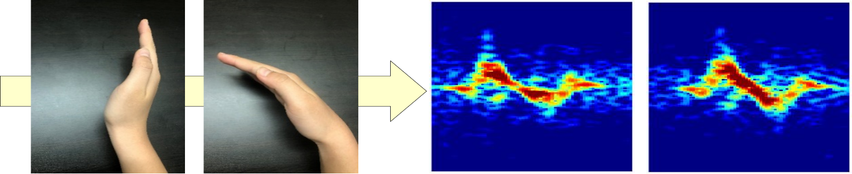
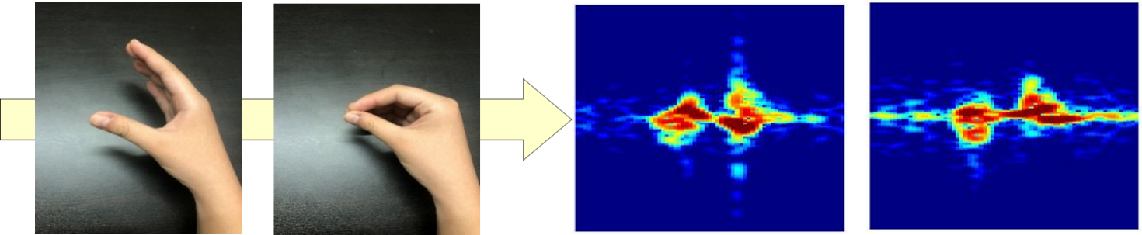
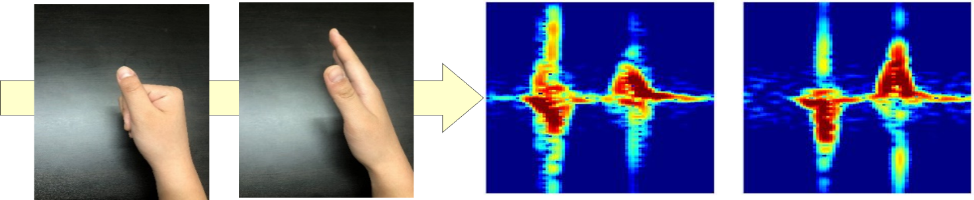
Gesture sensing with Radar and AI
The Future is Touchless: Radical Gesture Control Powered by Radar and Edge AI
19 January 2021
https://www.imagimob.com/blog/the-future-is-touchless-radical-gesture-control-powered-by-radar-and-edge-ai

Slide 6
Types of touchless technology
Gesture recognition
Gesture recognition is the most common form of no-touch technology. Users can do simple gestures to control or interact with devices without touching them. Waving your hand to trigger an automatic door, for example, removes the need to touch handles or a physical button.
Touchless sensing
Touchless sensing can detect the presence or motion of a person under a sensor. Like gesture recognition, touchless sensing has become rather commonplace in our every-day lives. Every one of us has gone through an automatic door at a grocery store, hotel, or commercial building. So every one of us has experienced touchless sensing technology.
Voice recognition
Voice recognition systems let users interact with technology simply by speaking to it. This has become popular especially in our homes. We can make hands-free requests, set reminders, and perform other simple tasks by talking to Apple’s Siri, Amazon’s Alexa, or the Google Assistant.
Facial recognition
Facial recognition takes things one step further since it doesn’t require a conscious effort by the user. Technology that can recognize your team opens up a world of possibilities and automation in the workplace. Like how the new iPhone can unlock with a glance at your screen, imagine a video conference starting when you walk into a room.
Personal devices
For technology to be completely touch-free it must operate without the need for physical contact, like in the examples above. But the introduction of smartphones and other personal devices have made nearly touch-free technology possible as well. Anything that operates at the command of your own personal device allows you to avoid touching public surfaces.

Slide 7
Some common types of touchless sensors
Radar
☺
☹
Examples
Camera
☺
☹
Examples
Infrared
☺
☹
Examples
Sound (microphone)
☺
☹
Examples
RFID
☺
☹
Examples

Slide 8
2. Flow Chart
Data and Signal/Data Processing Flow
Radar gesture echo signal
Radar Sensor
Digital Data
Gesture Identification
ML based
classifier
μ-Doppler
Spectrogram
STFT

Slide 9
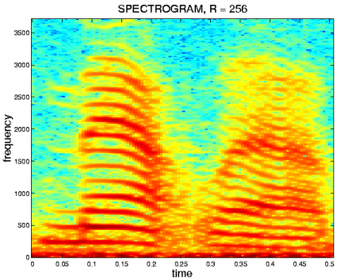
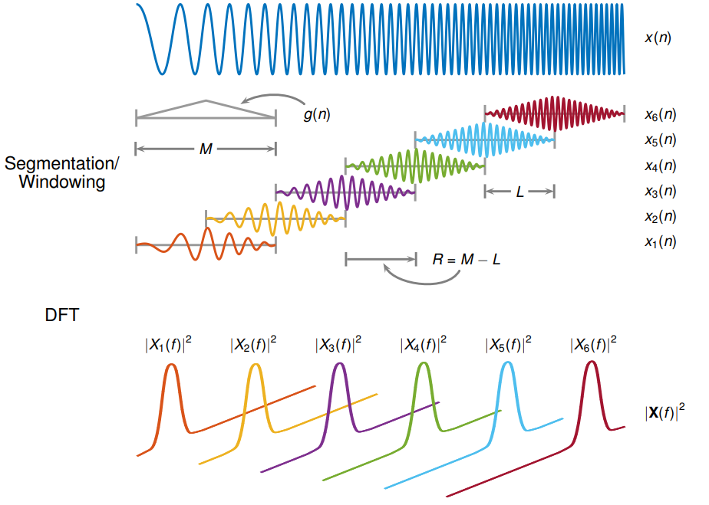
3. Radar Signal Processing
Illustration and example of STFT

Slide 10
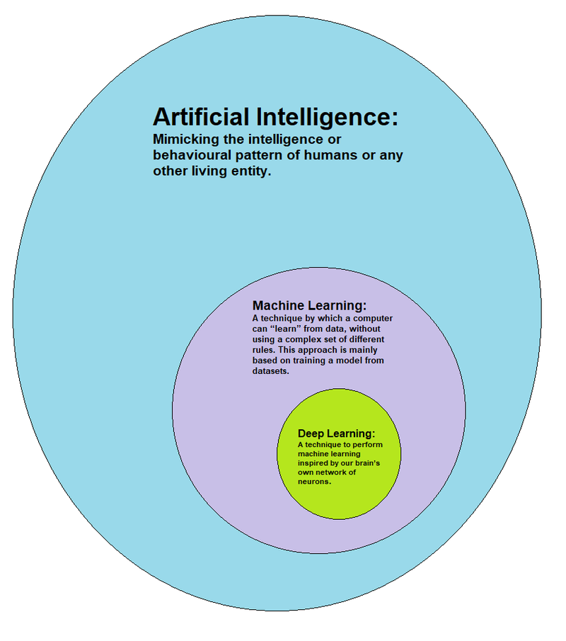
4. Artificial Intelligence
Relations about
Artificial Intelligence
Mimicking the intelligence of humans or other living entity
Machine Learning
To learn from data without using complex rules
Deep Learning
Inspired by brain’s network of neurons
Can do everything a mathematical model can do without requiring you to know which signal features to bring into the model.

Slide 11
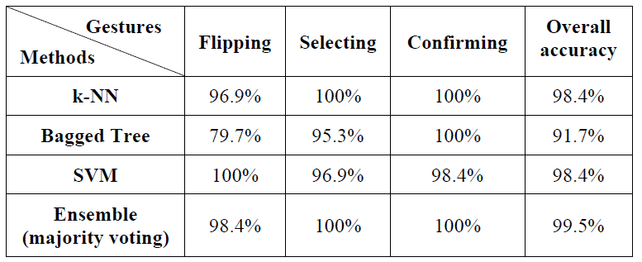
Machine Learning
Use one or few simple Machine Learning (ML) algorithms

Slide 12
5. Hardware & Development
Radar Sensor: Acconeer
https://www.acconeer.com/
https://www.acconeer.com/products
https://www.digikey.sg/en/supplier-centers/acconeer-ab?utm_adgroup=&utm_source=google&utm_medium=cpc&utm_campaign=Dynamic%20Search_EN_Product&utm_term=&productid=&gclid=CjwKCAjwx8iIBhBwEiwA2quaqzvyjV-rpGvzrTa2yJSgWSiQQL-LRsd8vrNdpYh26lQzTN-xqrBuxxoCXpIQAvD_BwE
Computer: Rasbery Pi
https://www.raspberrypi.org/
https://projects.raspberrypi.org/en/projects?software[]=python
Integration & Development
https://developer.acconeer.com/
https://github.com/acconeer/

Slide 13
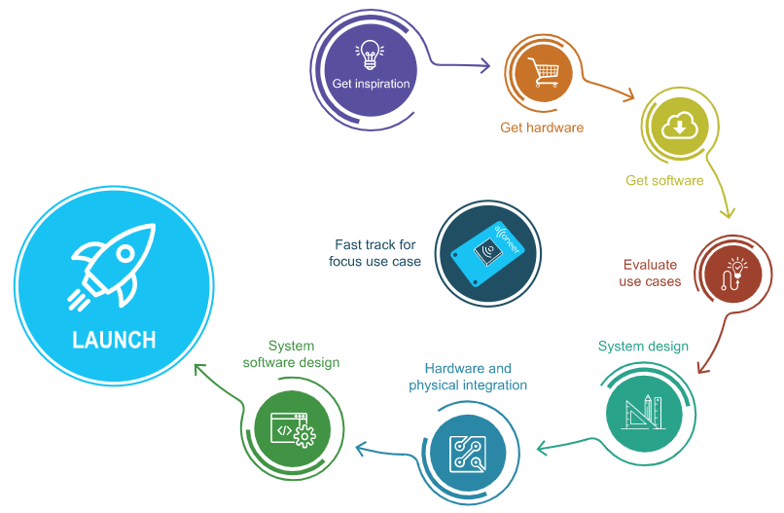
Development
https://developer.acconeer.com/

Slide 14
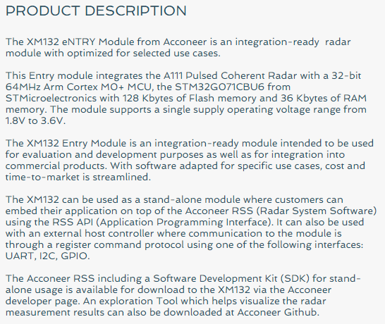
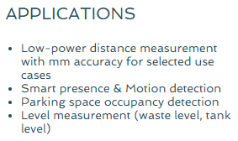
Product 1: XM132 ENTRY MODULE
XM132
A1 Radar sensor module
XE132
Evaluation board including XM132

Slide 15
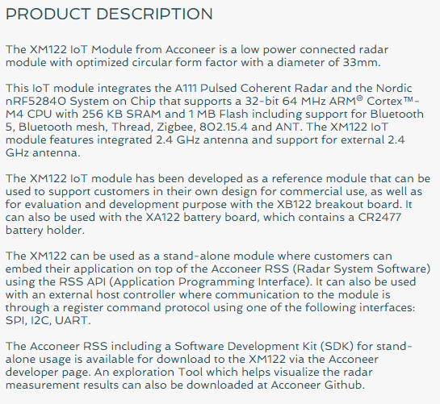
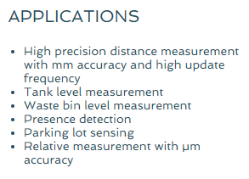
Product 2: XM122 IoT MODULE
XM122
IoT RADAR SENSOR MODULE
XB122
BREAKOUT BOARD FOR XM122
XA122
BATTERY BOARD FOR XM122

Slide 16
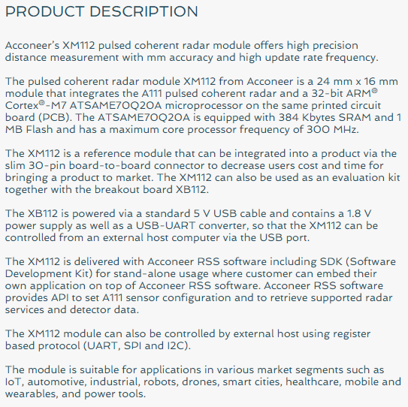
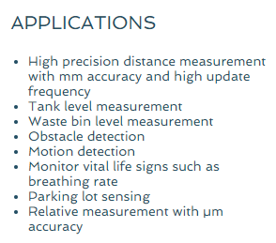
Product 3: XM112 HIGH PERFORMANCE MODULE
XM112
A1 Radar sensor module
XB112
Breakout board for XM112

Slide 17
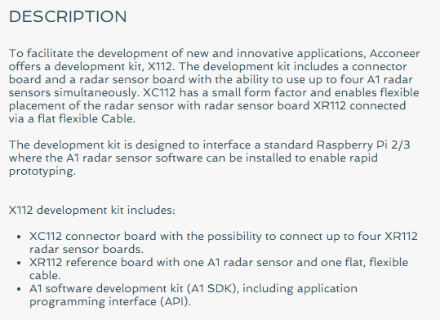
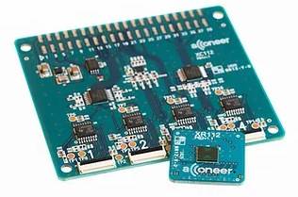
Product 4: DEVELOPMENT KIT
XC112
A1 connector board with flex cable connectors
$198.94
XR112
XC112A1 radar sensor board with flex cable
$48.68

Slide 18
Background References
Gesture Sensing
The Future is Touchless: Radical Gesture Control Powered by Radar and Edge AI
https://www.imagimob.com/blog/the-future-is-touchless-radical-gesture-control-powered-by-radar-and-edge-ai
The emerging need for touchless interaction technologies
https://interactions.acm.org/archive/view/july-august-2020/the-emerging-need-for-touchless-interaction-technologies#:~:text=The%20Covid%2D19%20pandemic%20has,us%20to%20avoid%20touching%20devices.&text=The%20gesture%2Dbased%20technologies%20that,popular%20outside%20of%20research%20labs
Is the future of touchscreens touchless
https://www.itpro.co.uk/hardware/357609/is-the-future-of-touchscreens-touchless
Google soli
https://www.youtube.com/watch?v=0QNiZfSsPc0&t=8s
https://www.youtube.com/watch?v=QS8SW-ouM5w
https://www.youtube.com/watch?v=Na89OzXllkk

Slide 19
Technical References
Short-time Fourier transform (STFT)
https://www.mathworks.com/help/signal/ref/stft.html
https://www.youtube.com/watch?v=NA0TwPsECUQ
https://www.youtube.com/watch?v=TZzS52OplYs
Fourier Transform, Fourier Series, and frequency spectrum
https://www.youtube.com/watch?v=r18Gi8lSkfM

Slide 20
Problems / Questions

